Slide 1

Pandas
Project 2 prep
Module 11
Programming for Data Science
Pandas and activities.
Mar 12, 2020 [gb]; updated Mar 17

Slide 2
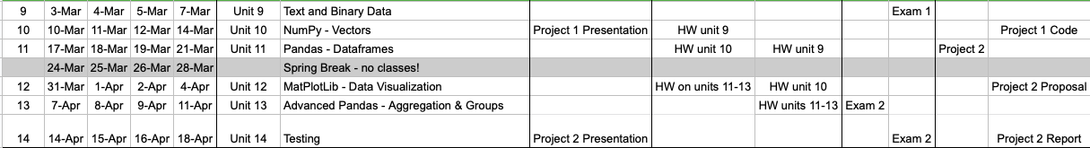
1. Today’s activities
Intro to Project 2; Teams & coordination
Overview of Data Exploration & Analysis; Architectures and analytics
Pandas - really more of an exploration of possibilities
Demos in resources folder; class activity
Team Discussions (breakout rooms to get to share ideas and perhaps establish a team for the last project)
Next week: visualization
Calendar

Slide 3
2. Activity Room 1:
Spend about 10-15 minutes in breakout rooms discussing ideas and building a team.
You can create teams across sections but let all instructors know.
If you have a team already, we’ll have a breakout room just for you; others assigned however … just lmk.
Tho obvious - plan times to meet, contact info, assign tasks.

Slide 4
3. Analysis activities - overview
optional tech tangent
Identify data sources/streams
Get to know the content and structure
Dimensionality reduction
Harmonize integration; create new/delete/merge columns
Domain, range; MCT (usual stats)
Start with a version of“data cleansing”, “data cleaning”, “warehousing”, KDD (knowledge discovery in databases);
Optional data cleaning slides in resources; Data Mining article
Common: researchers, others use Excel, R, Stata, SQL, .json
Proceed from data, to intermediary sources, to special-purpose architectures

Slide 5
3. Analysis activities - overview
optional tech tangent

Slide 6
3. Typical architecture for analysis
Compare to Hadoop, Spark; data mining
hypothesis confirmation or hypothesis generation
http://www.byteorigin.com/services/cloud-application-development/big-data-analytics/

Slide 7
3. Typical architecture for analysis
optional tech tangent
Overview of Hadoop: software components and architecture (master/slave and task submission/tracking)
(con’t next slide)
See the Hadoop book in the resources folder on github.

Slide 8
optional tech tangent

Slide 9
3. Exploration & Analysis
Data Exploration
For data integrity
Explore to develop questions based on the variables you have
Try to break your model … better now than in production!
Data Analysis
to answer a research question or hypothesis*
Usually involves complex math, modeling, statistics
Likely to combine multiple datasets
Explore your data by collapsing in grouping in various ways
Some functions are useful in both exploration and analysis.
Be careful using research/stat terms in a casual way - some terms have specific implications, such as “correlation”, “research question”, “proved”, and more.

Slide 10
3. Exploration & Analysis
Take the time to get familiar with the data! Consider the domain & range of the data; measures of central tendency; parametric or non-parametric? Use some handy basic commands:
value_counts()
describe()
min(), max(), isnull(). Check for NaN, empty vars, 0s.
Typical plots help explore the data (histogram, scatter, bar chart)
More on the visualization parts in Module 12.

Slide 11
3. Exploration & Analysis
Consider the source(s) of your data (dataset documentation)
Research the topic …
Tho not a research or stats course, consider “threats to validity” [research bias, lack of precision in definitions]; cross-validation and your data.
e.g., if the variable “hospital_los” means “length of stay”, we should be able to compare this to other vars, such as “admit_date” and “discharge_date”
Cross-validate outside your data.
By the way, for a good intro/review of research, see this book …
[any professional gold-standards, confounding events?]
E.g., we expect electrical power to cost more when demand is - let’s find the max power cost in the dataset and compare to daily temps to ensure it makes sense (would have to consider parametric/non-parametric and chi-square but that’s for another course (grin))

Slide 12
3. Data Exploration & Analysis
Think about analysis as a series of dataset transformations … how to explore our data? Maybe …
filter rows based on some condition (too high, not applicable, duplicated data)
create new columns when necessary
aggregate or collapse by groups (may be better to deal with x number of groups than a zillion individual data points; think of statistical error, too)
join two or more datasets together (not without its own problems, tho, e.g., NaN; may need intermediary “cross-walk”, akin to a database cursor - also for another course)

Slide 13
4. Pandas (finally!)
A quick visual reminder of some groups of commands, grouped by function, to help manage and analyze data.
See the resources git folder.
Optional: see https://www.tutorialspoint.com/python_pandas/python_pandas_visualization.htm
https://pandas.pydata.org/pandas-docs/stable/10min.html

Slide 14
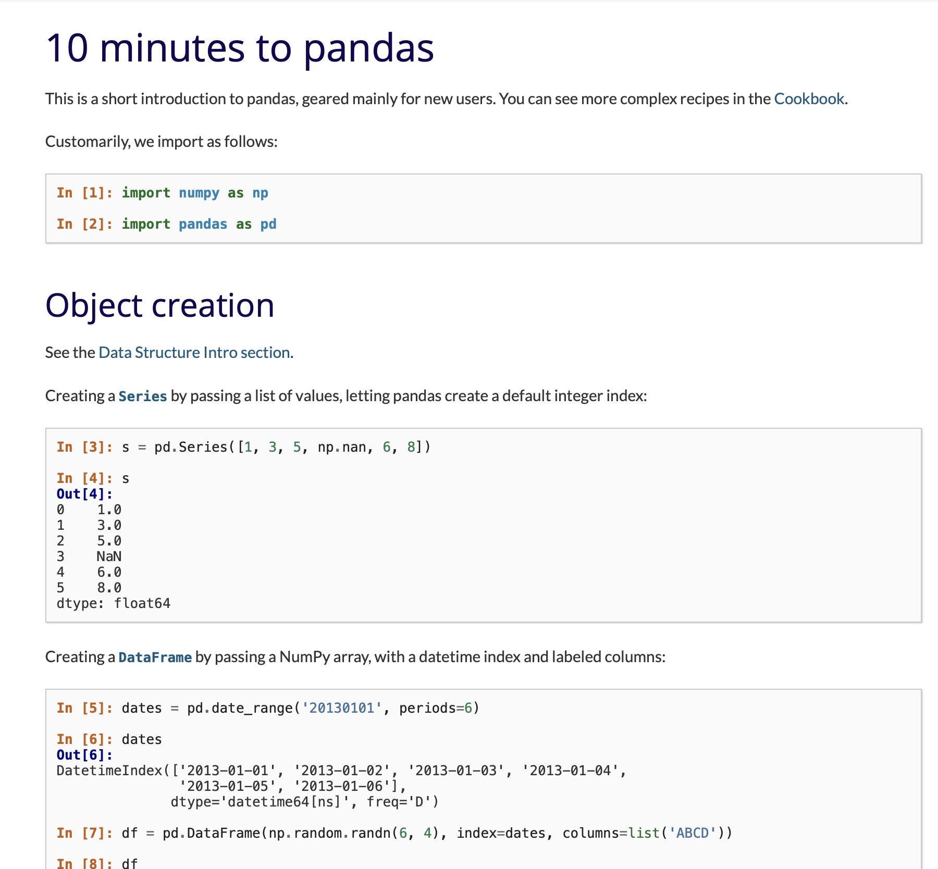
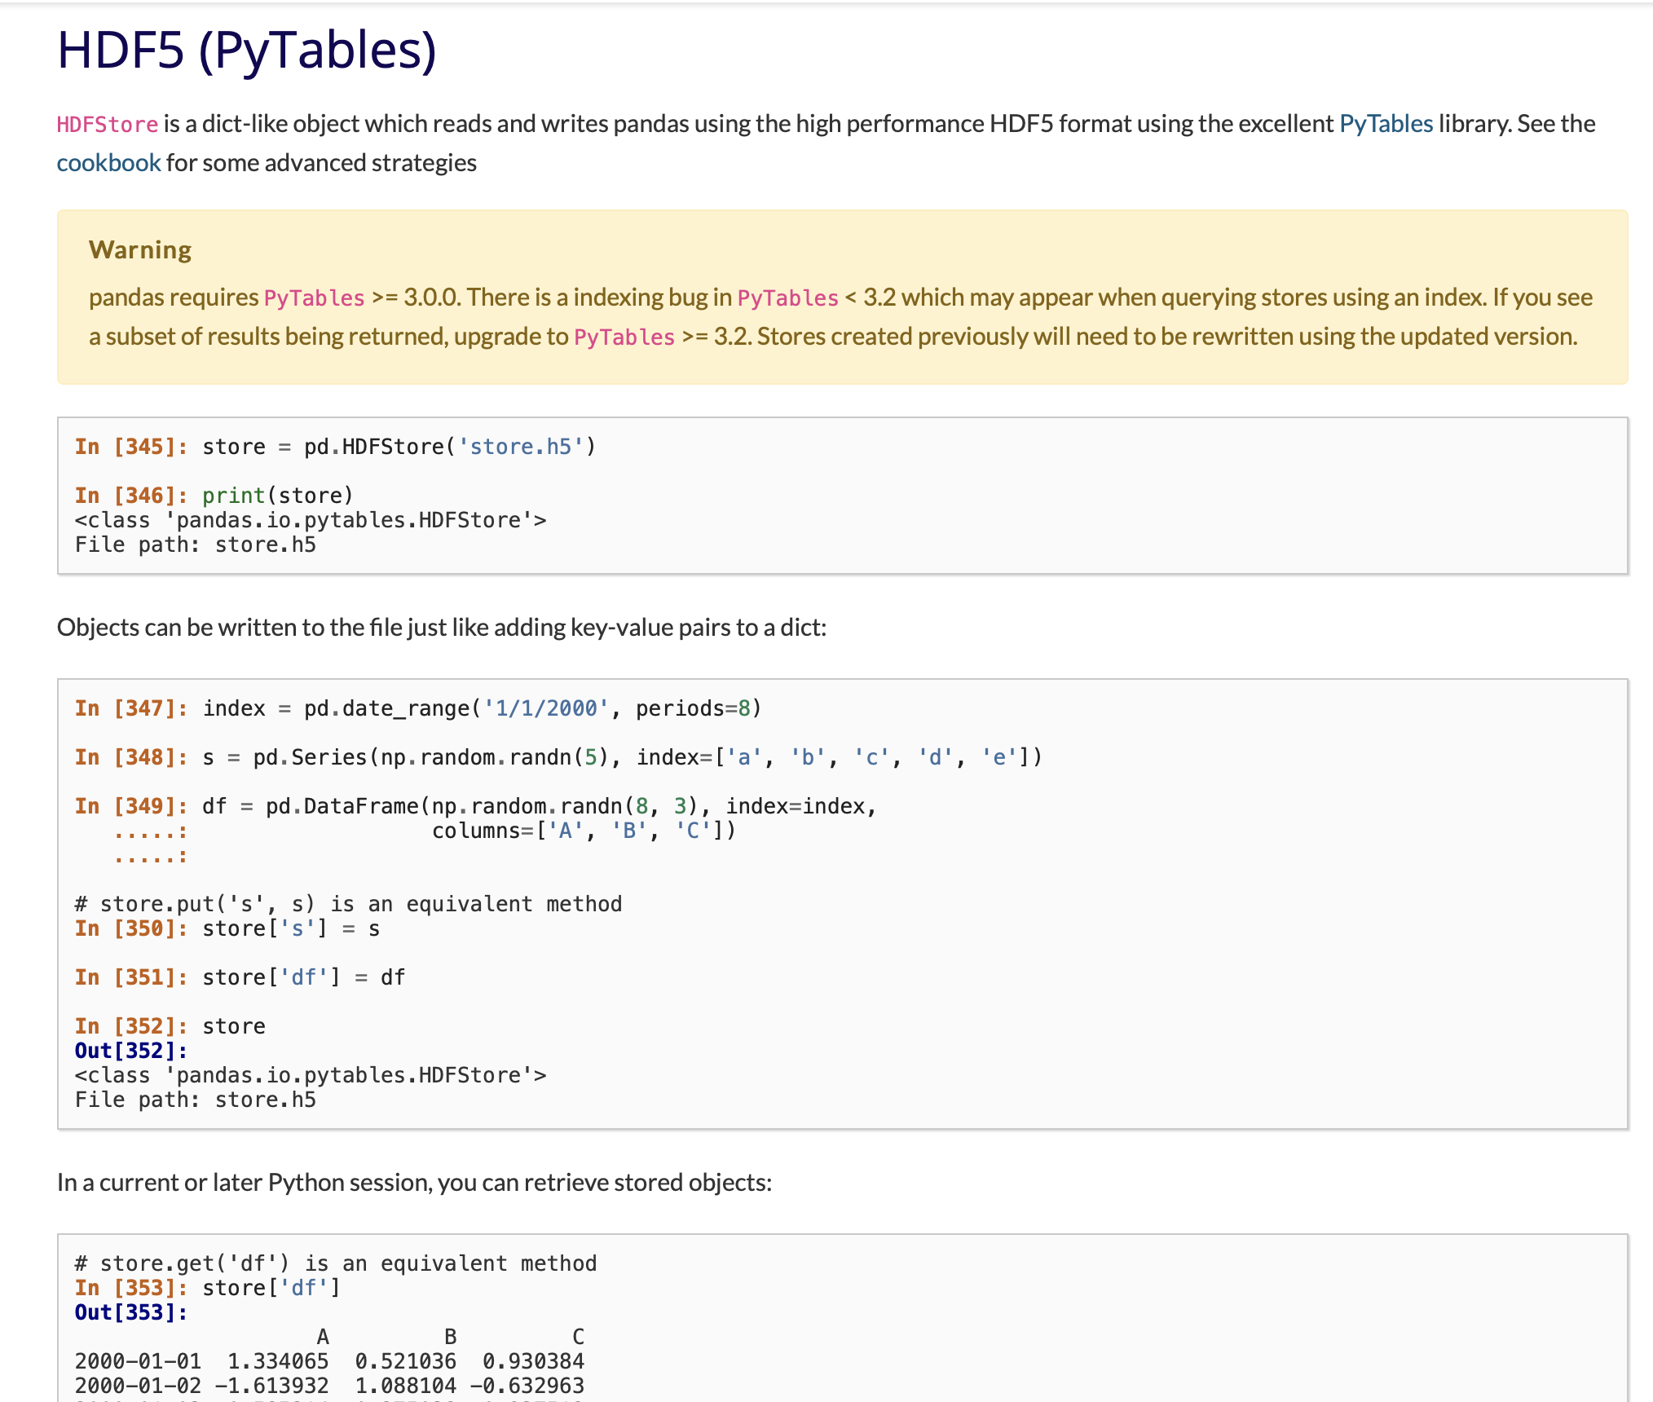
optional tech tangent
These optional tech tangent slides were added to suggest to students a variety of more-efficient problem-solving techniques when working with files and analyses. Pandas has a lots of tools for I/O with
CSV & Text
JSON
HTML
Excel
OpenDoc
Binary Excel
Clipboard
Pickling
msgpack
Feather
Parquet
ORC
SQL
GoogleBigQuery
Stata
SAS
SPSS
and more
https://pandas.pydata.org/pandas-docs/stable/getting_started/10min.html
https://pandas.pydata.org/pandas-docs/stable/user_guide/io.html#io-hdf5

Slide 15
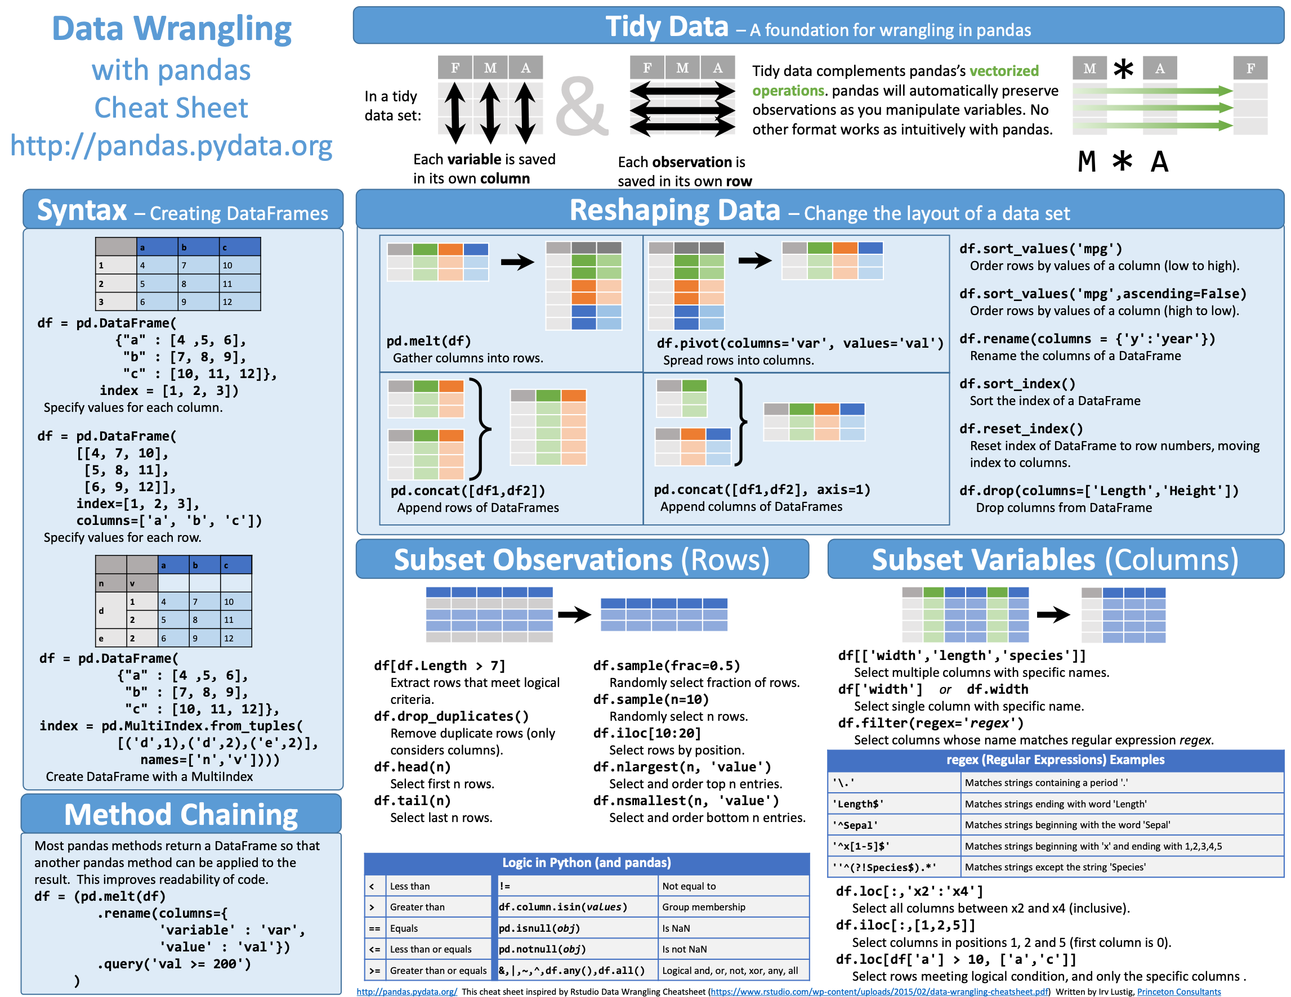

Slide 16
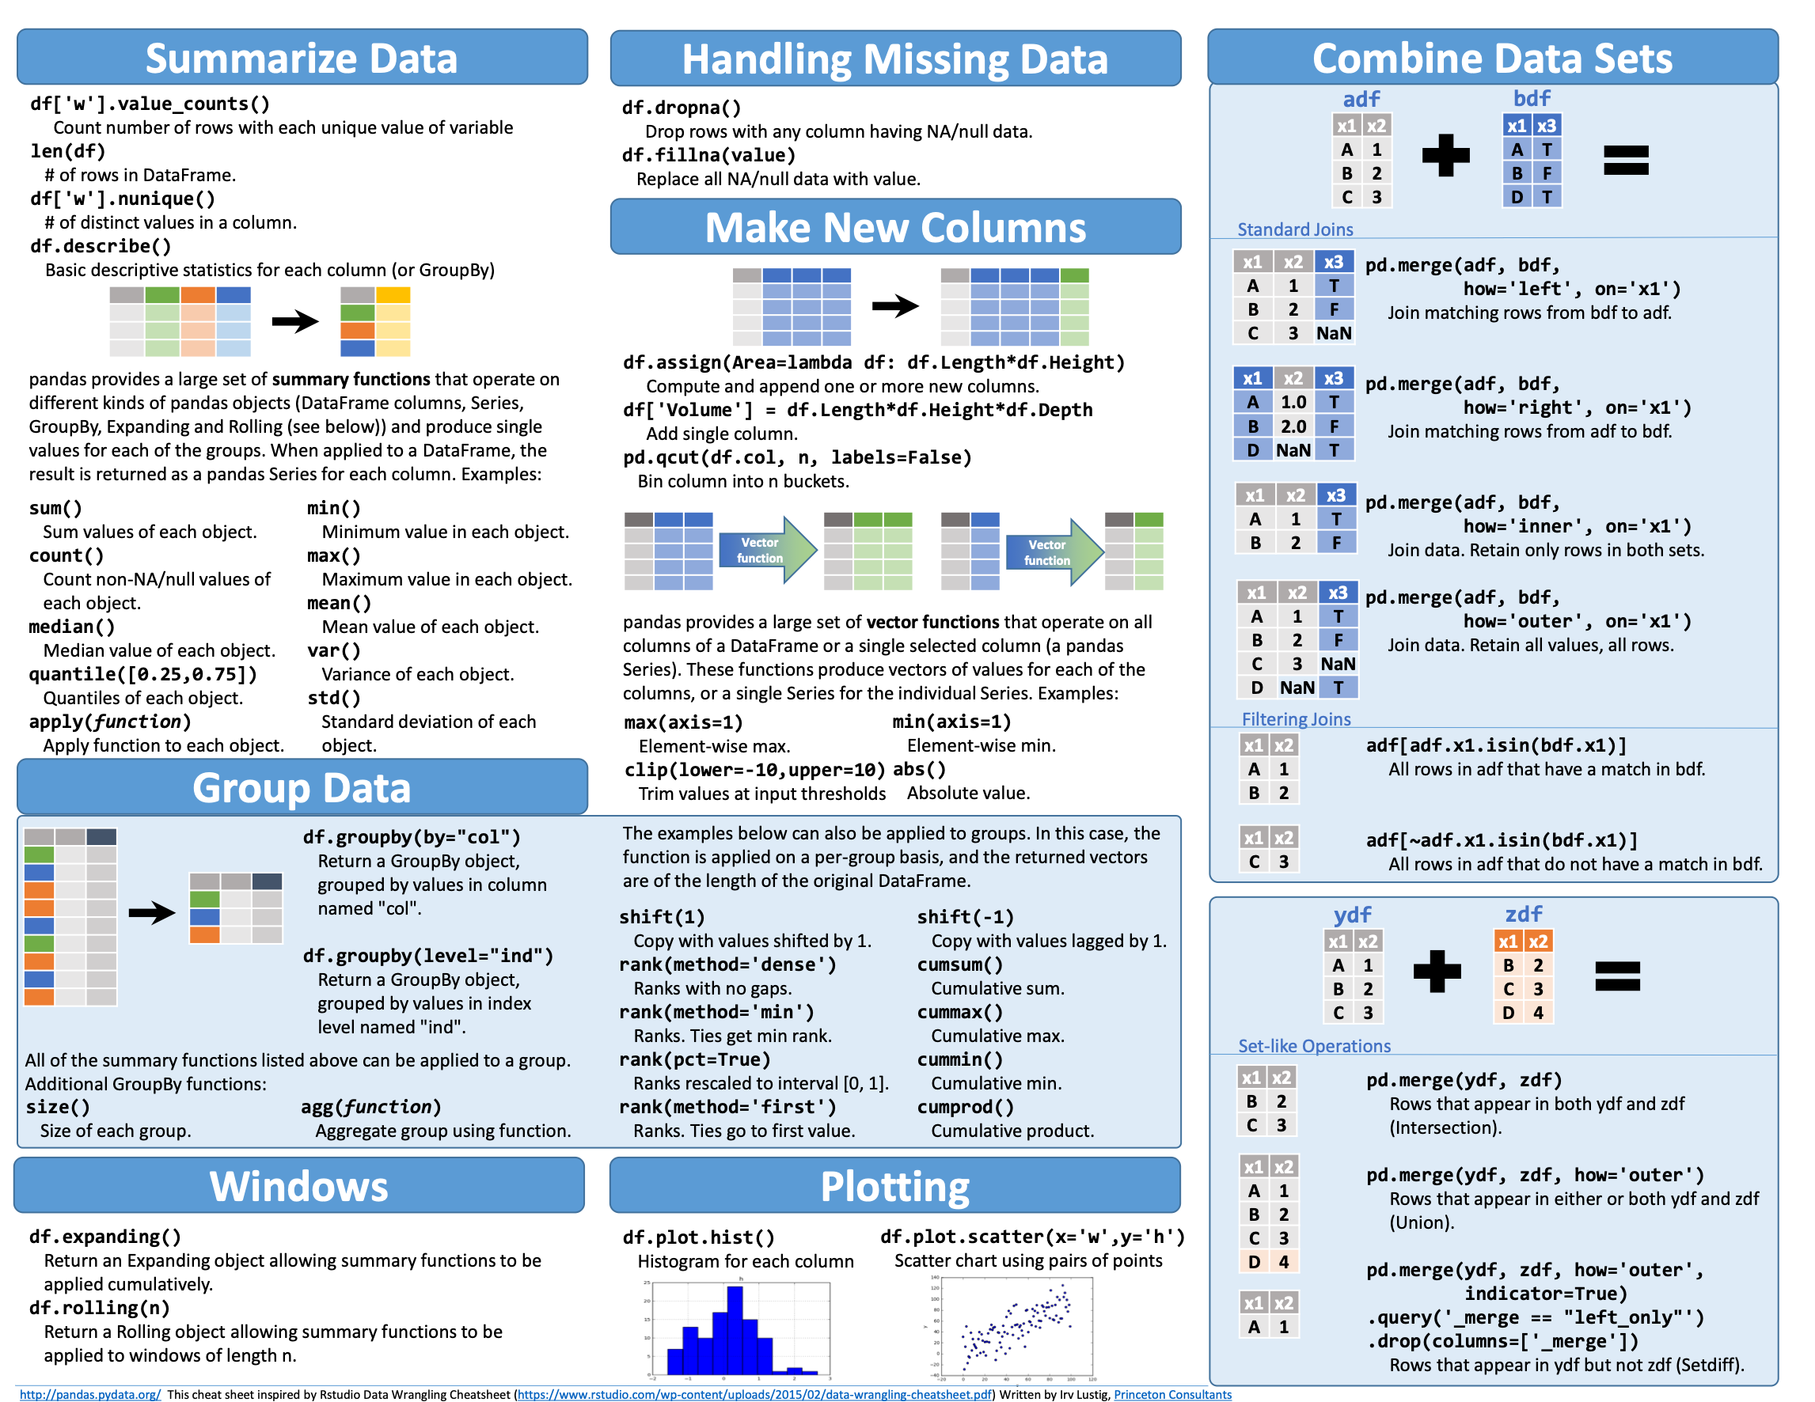

Slide 17
 |  | Description | example
Series | 1 | 1D labeled homogeneous array, sizeimmutable. | #import the pandas import pandas as pd import numpy as np data = np.array(['a','b','c','d']) s = pd.Series(data) print s
Data Frames | 2 | General 2D labeled, size-mutable tabular structure with potentially heterogeneously typed columns. | import pandas as pd data = [1,2,3,4,5] df = pd.DataFrame(data) print df
Panel | 3 | General 3D labeled, size-mutable array. | # creating an empty panel import pandas as pd import numpy as np data = np.random.rand(2,4,5) p = pd.Panel(data) print p

Slide 18
4. Pandas
In the breakout, start with asking
what’s the maximum donation?
the most common occupation who donated this amount?
in what zip code area do the most people identified in #2 live?
The subsequent slides compare questions we’d ask with pandas commands.
Think of some scenarios - why check the head() of the dataset?
https://github.prod.oc.2u.com/UCB-INFO-PYTHON/assignments_upstream_spring20/tree/master/resources/pandas-lots-of-demos

Slide 19
data = pd.Series([1,2,4,6,0,85,45,7,53,321,4,32,2355,6]) | # Let’s experiment with this series
data[data < 10] | # select values < 10
data[(data < 10) & (data > 5)] | # how ‘bout a range with keywords
data[data < 10][data > 5] | # same result but “chained” >>> data[(data < 10) & (data > 5)] 3 6 7 7 dtype: int64 >>> data[data < 10][data > 5] 3 6 7 7 dtype: int64
# using booleans as counter: (data > 5).sum() | # True = 1; False = 0
Slicing & Manipulating
d5 = data.head().copy() | # make a copy … for safety!
d6 = data.head(70).copy() | # specify the size of the head (ceiling, e.g., up to 70)
data[0:10:2] | $ standard slicing - [start:end (exclusive):step]
data[0] = 10000 | # value replacement
d5_6 = pd.concat([d5, d6])

Slide 20
any and all tests for series
data[data < 10].any() | # true
data[data < 10].all() | # false
(data > 10000).any() | # Alternatives … false
(data > 0).all() | # false
len(data)
data.mean() data.mode() data.median() data.count() data.std() data.unique() | # can get individual “measures of # central tendency … or use # describe() for the whole thing! >>> data.describe() count 16.000000 mean 640.312500 std 2496.070718 min 0.000000 25% 2.000000 50% 4.000000 75% 16.500000 max 10000.000000 dtype: float64
data.value_counts() | # super useful … experiment
data.shape | # note that this is an attribute, # not a method.

Slide 21
data[10] | # by single index names
data[ [10,20] ] | # by multiple index names
 | # if the index is not numeric, pandas interprets numbers as row number
d5.iloc[ [0,3] ] | # lookup by index location “dict style[]”
data.index = range(100, len(data) + 100) | # set new index names
data.loc[ [100, 103] ] | # we can use .loc to call by index names
data.iget( [0,3] ), data.ix( [0,3] ) | # Depreciated - don’t use
data.index = New_Index | # overwrite the existing index
new_data = data.reindex([0,2,15,21]) | # slide out rows and use their indices; missing values get “NaN”
data.reindex([0,2,15,21], fill_value=0) | # specify the missing values

Slide 22
combo.reindex([0,2,15,21], fill_value=0) | # set fill value
new_combo.fillna(0) | # fill those NaNs!
Forward and backward fill - guess at missing values - common in practice
new_combo.ffill() | # take forward fills …
new_combo.bfill() | # take backward fills
new_combination.interpolate() | # fills missing values with linear interpolation *Note! There are several important techniques for missing values.
s1 = pd.Series([‘1’, ‘3’])
s1 = s1.astype(int) | # what does this do to s1?
s1.map(lambda x: x**2) | # pass a series to a lambda function
s1.map({‘1’:2, ‘2’:3, ‘3’: 12}) | # basic mapping with a dictionary

Slide 23

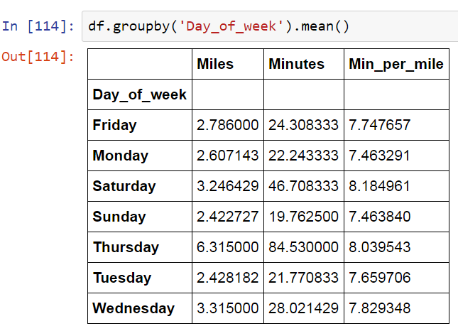
pd.DataFrame([upcase, lcase]) | # make a DataFrame from a series
pd.DataFrame({‘lowercase’: class, ‘uppercase’:upcase}) | # can pass column names
letters.columns = [‘LowerCase’, ‘UpperCase’] | # explicitly set the columns
letters.index = lcase | # change the indices
letters.sort_values(‘Number’), letters.sort_index() | # sort by column or by index
letters[ [‘LowerCase’, ‘UpperCase’] ] | # slide columns by name
Viewing your data by a category can yield critical insights groupby

Slide 24
Summary
Today we looked at trends towards working in data science by considering …
architecture for large data processing/analysis
exploring and analyzing data practices
introduced the bridge to research practices and converting our questions into code
using pandas
And getting ready for your final project.

Slide 25

Good luck with your projects!
Your presentations focus on your
communication of your project, not the tech notes.
がんばろう！
حظا سعيدا!
¡Buena suerte!
सौभाग्य!
Удачи!
ਖੁਸ਼ਕਿਸਮਤੀ!
اچھی قسمت!
સારા નસીબ!
Viel Glück!
祝好运！
Du courage! Keep going!

